Slide 1

Week 2 Pitch
Level 4/5 Group 14: Ethan Ward, Mircea Lazar, Petrut Vasile, Toby White

Slide 2

Target audience
Core audience
Ages between 11-19
Male
Competitive gamers

Slide 3

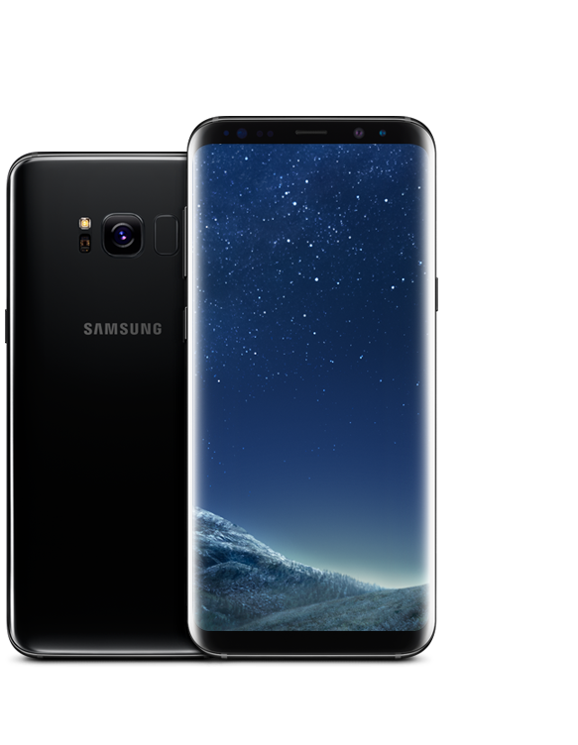


Markets and platform
Platform
Mobile phones
Supported platforms: Android and IOS
Markets
Smartphone markets
Google play store
IOS App store

Slide 4
What are the games challenges?
Getting the projectile to hit the player which is on the other side of the screen
Timing the shot
Knowing how much power to have to hit the target
Being able to hit the other player when there is wind involed

Slide 5
What is the core game loop?
Wait for the shot to be in the right position
Tap to set the position, tap again to charge the shot
The shot will then be locked in
The other player will have their go and when both shots are locked in the projectiles will fire
This keeps the symmetry

Slide 6
What does the player do?
Players will take turns in firing projectiles at each other.
The angle of the launcher will be changing until the player taps and holds, at this point it will lock into place.
The player will then be able to choose how much power to give the shot by how long they hold on the screen.
When the player lets go the shot will lock in and the other player will have their turn.
When both players have selected their shot angle and power the projectiles will fire.
The end goal will be for one player to get the other persons health to zero.

Slide 7
Concept art

Slide 8
First mechanic: shooting/launching
The player will tap and hold to set the position of the launcher
As they hold the power of the shot will charge
When the player lets go the shot will lock in and the other player will have their go
When both players have aimed and set the power, both shots will go at the same time.

Slide 9
Second mechanic: Wind
There will be a force (wind) that effects the projectile when it is launched.
Notes:
On some turns there will be wind that can affect the projectile. to make sure that this is fair for each player, the same force will be applied for both shots.

Slide 10
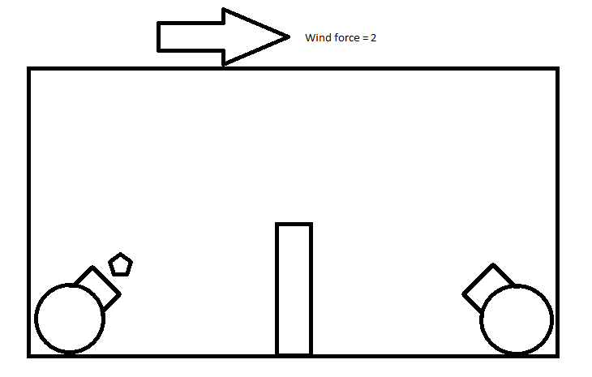
To keep things Symmetrical
Player 1
Player 2
Notes:
The same force will be applied to each of the players turns to keep things symmetrical

Slide 11
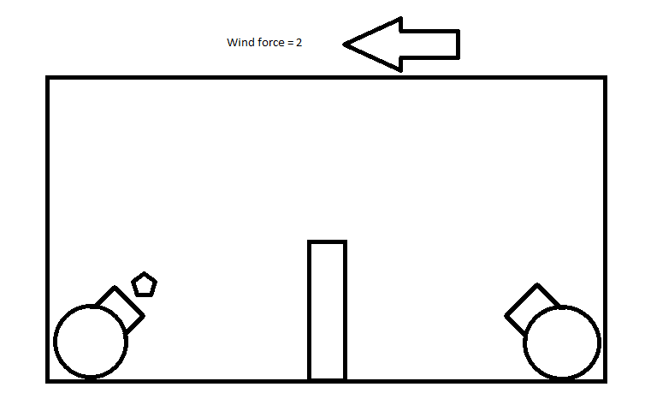
To keep things Symmetrical
Player 1
Player 2
Notes:
The same force will be applied to each of the players turns to keep things symmetrical

Slide 12
The player experience
We want both of the players to experience a sense of hard fun
Fiero, strategy and obstacles
A sense of people fun
Amusement and player interaction

Slide 13
The following week

Slide 14
Questions

